Slide 1
A Presentation on Project NBI.
Team Members: Komali Priyadarshini Myla
Ajay Kumar Vemula
Sai Kumar Mudhagoni Chaitanya Swaroop Udata

Slide 2



Beekeeper Studio
Installation

Slide 3
Milestone - 01

Slide 4
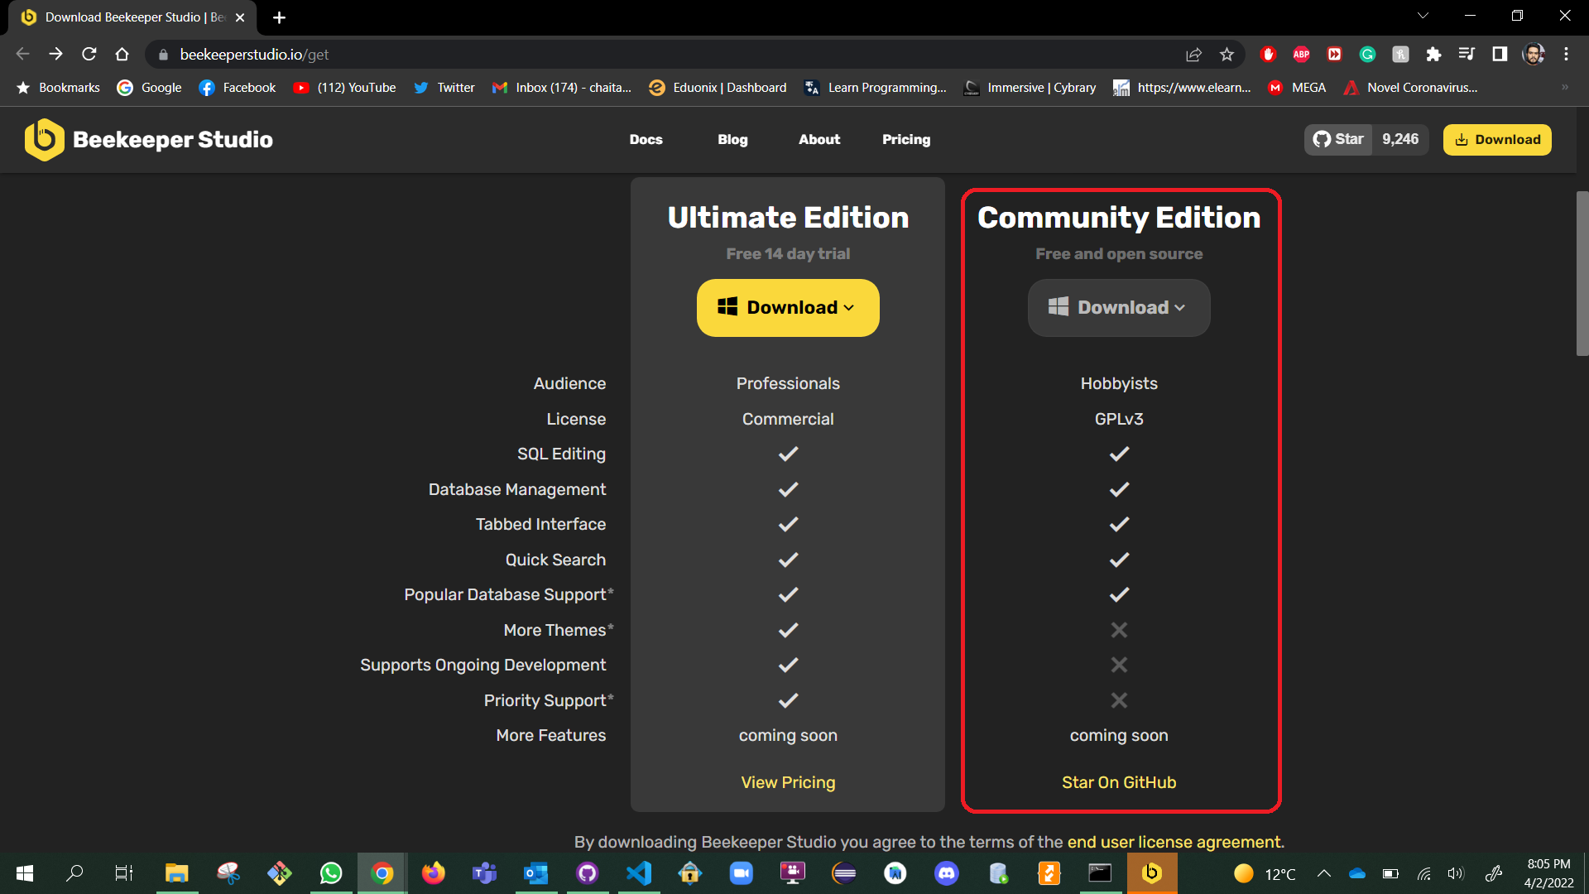


Steps
Link to download:- https://www.beekeeperstudio.io/get
Select the Community Edition.

Slide 5
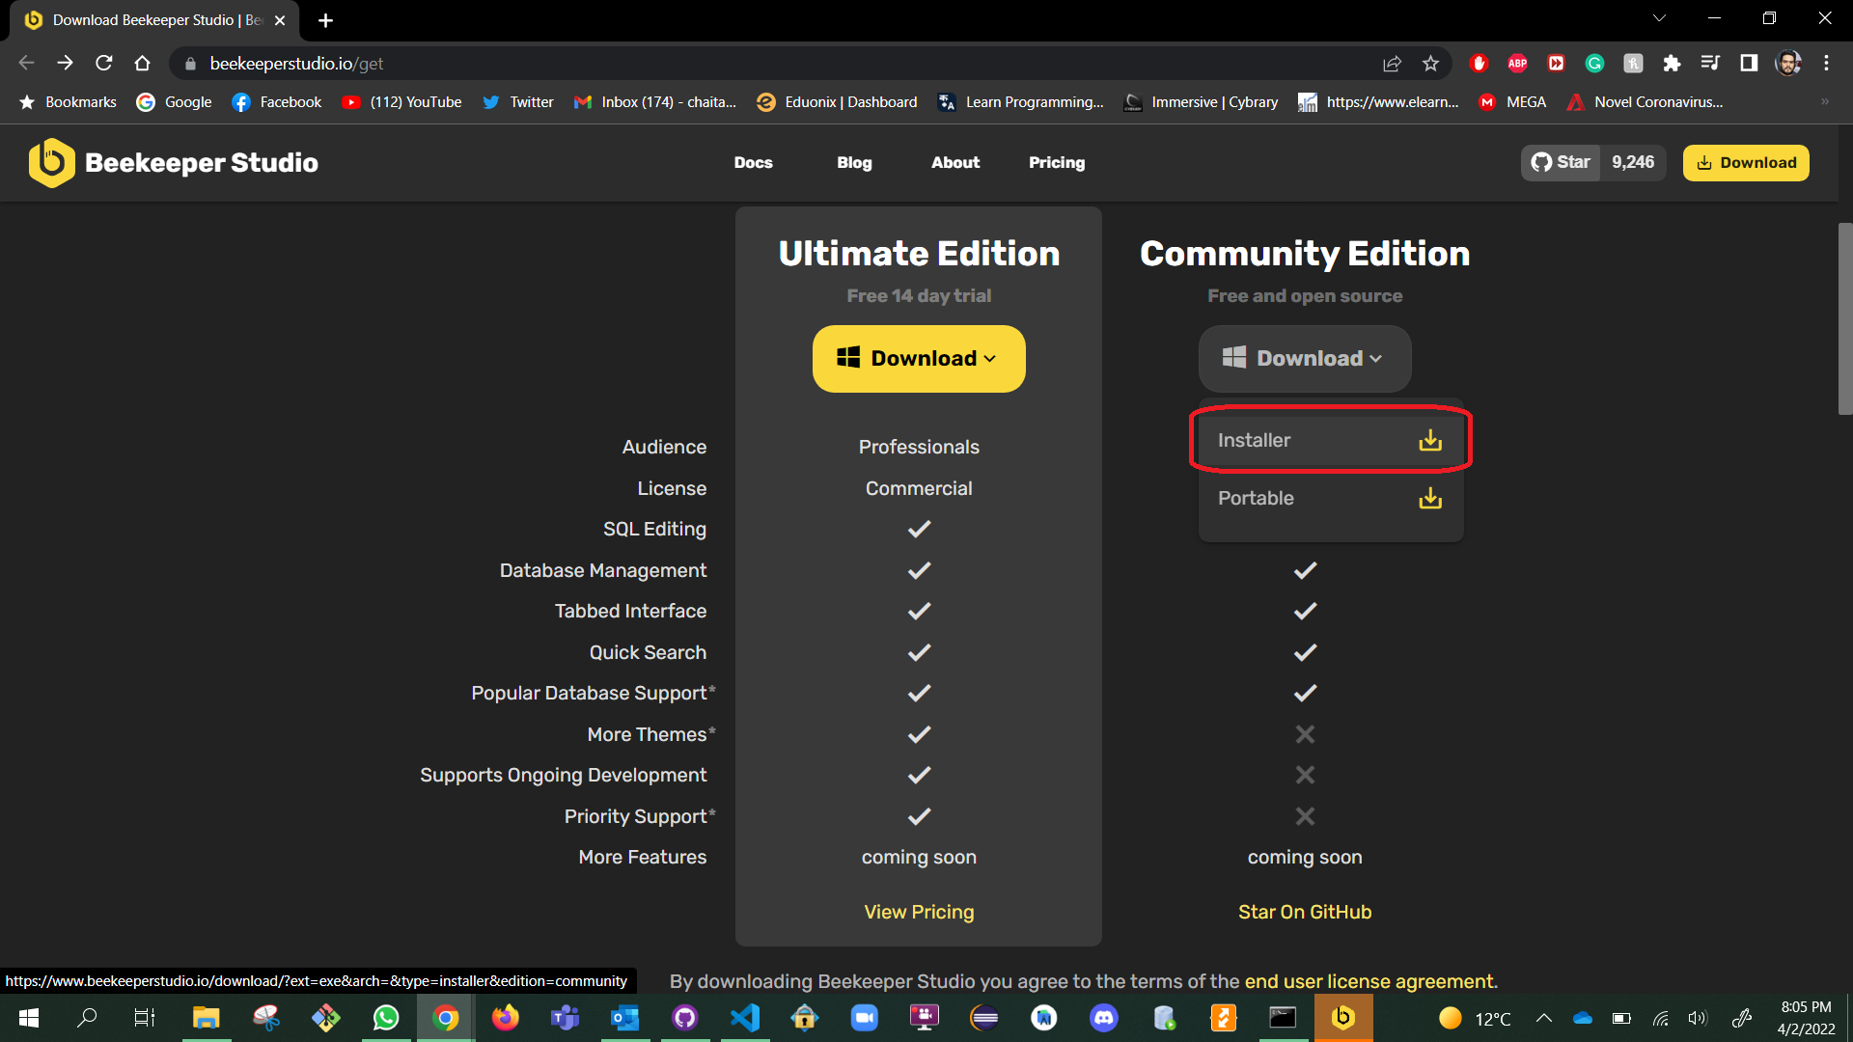
After Clicking on Download choose “Installer” edition

Slide 6
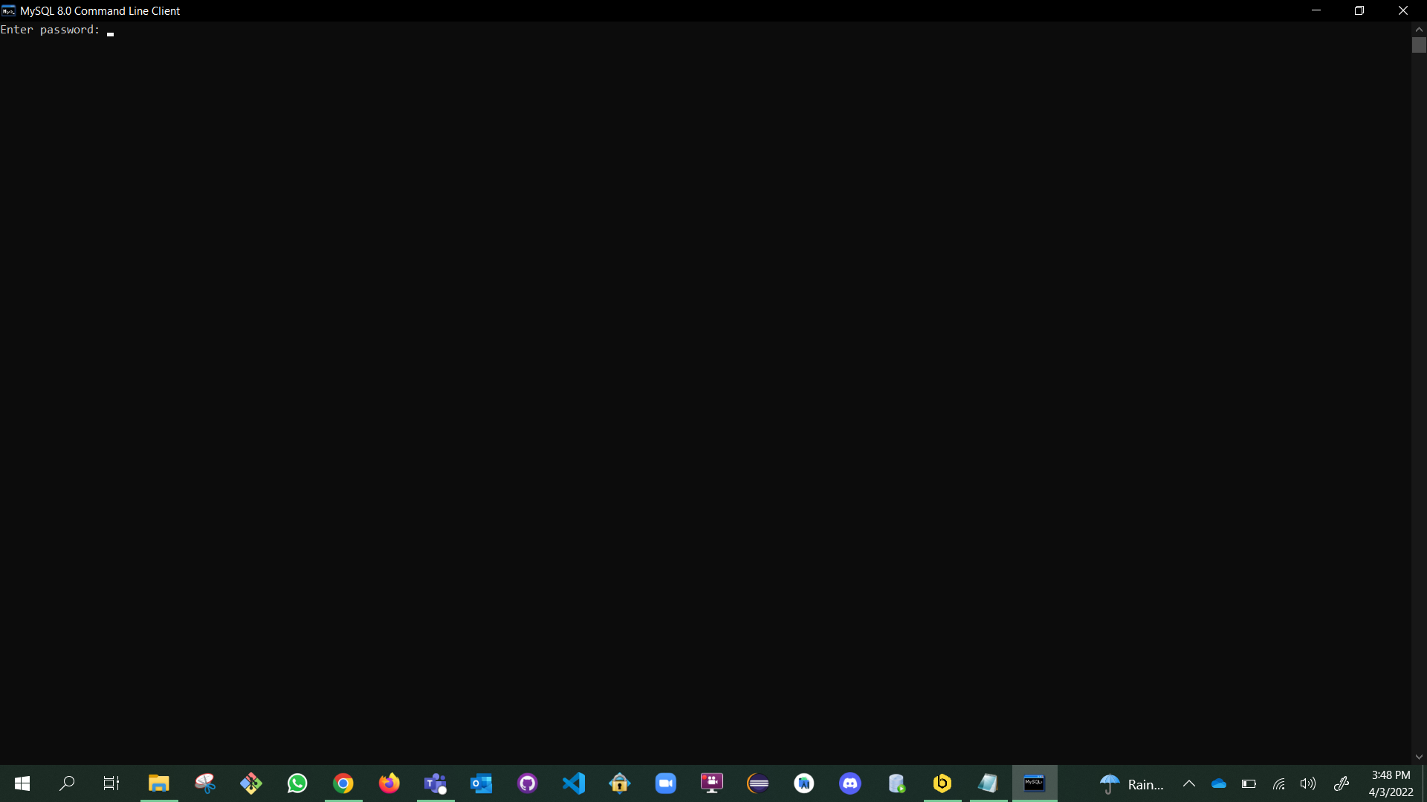
Open MySQL 8.0 Command Line Client & click Enter.

Slide 7
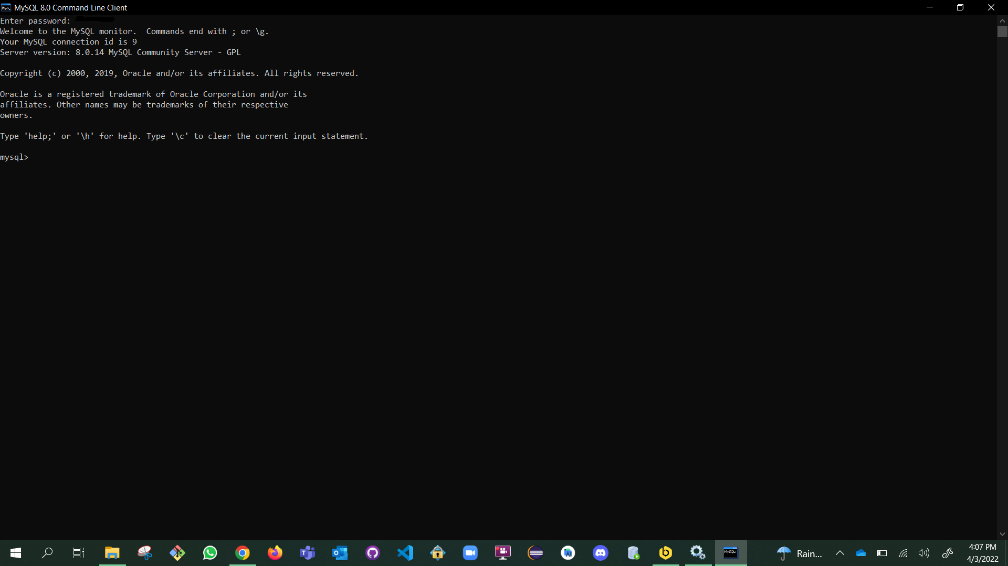
After Clicking on Enter it shows the command prompt as shown here.

Slide 8
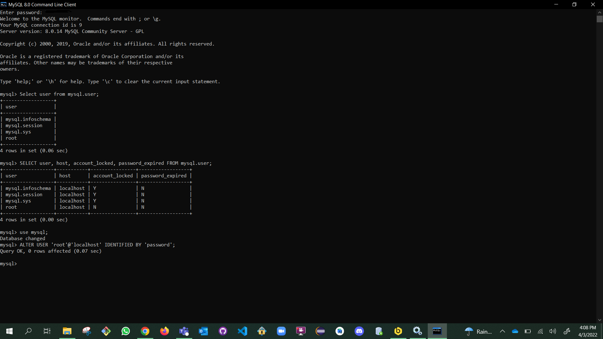
Enter the Commands step by step.
Select user from mysql.user;
SELECT user, host, account_locked, password_expired FROM mysql.user;
use mysql;
ALTER USER 'root'@'localhost' IDENTIFIED BY 'password’;

Slide 9
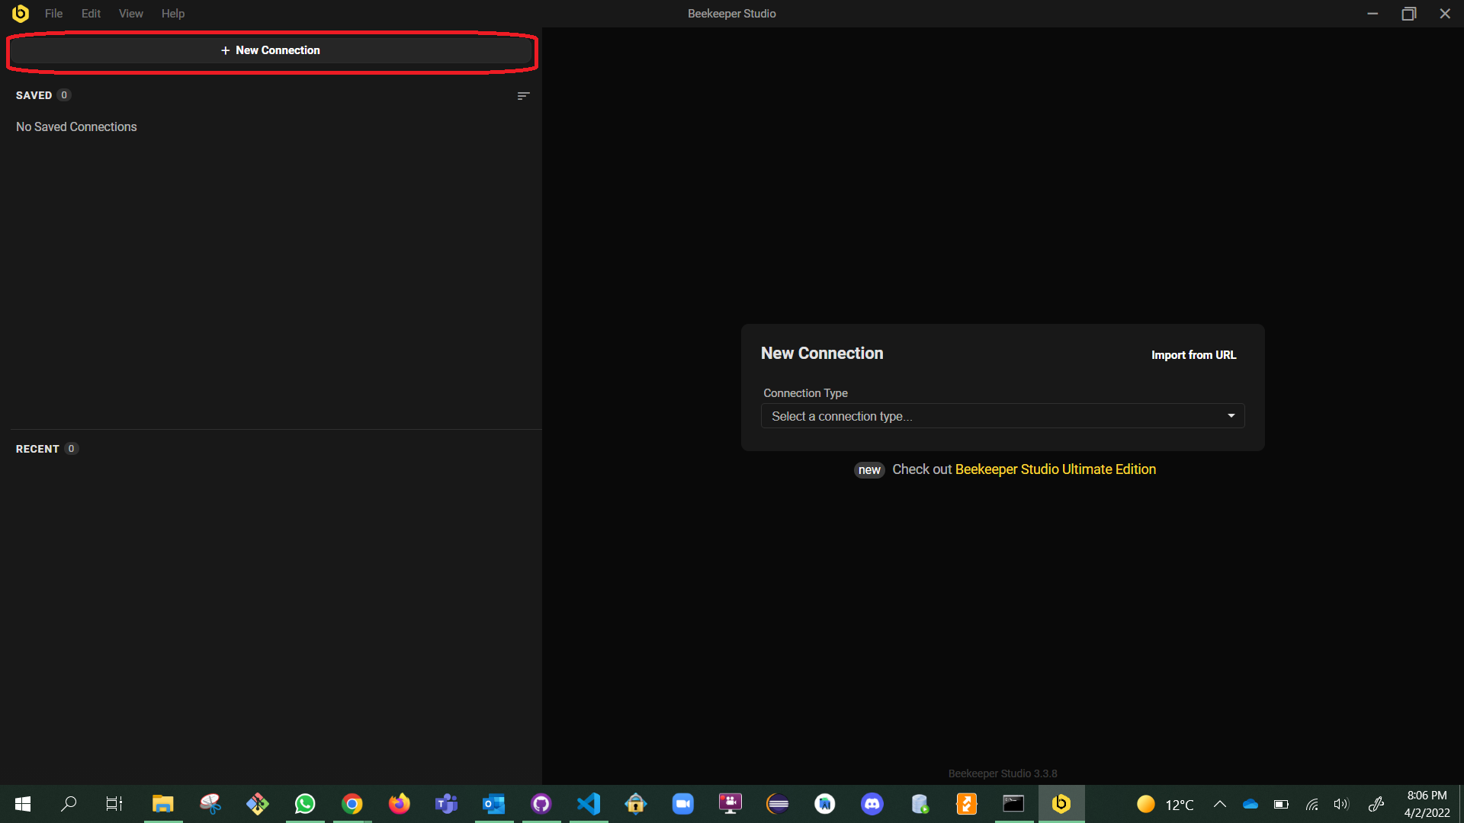
Open the “Beekeeper Studio” and click on New Connection.

Slide 10
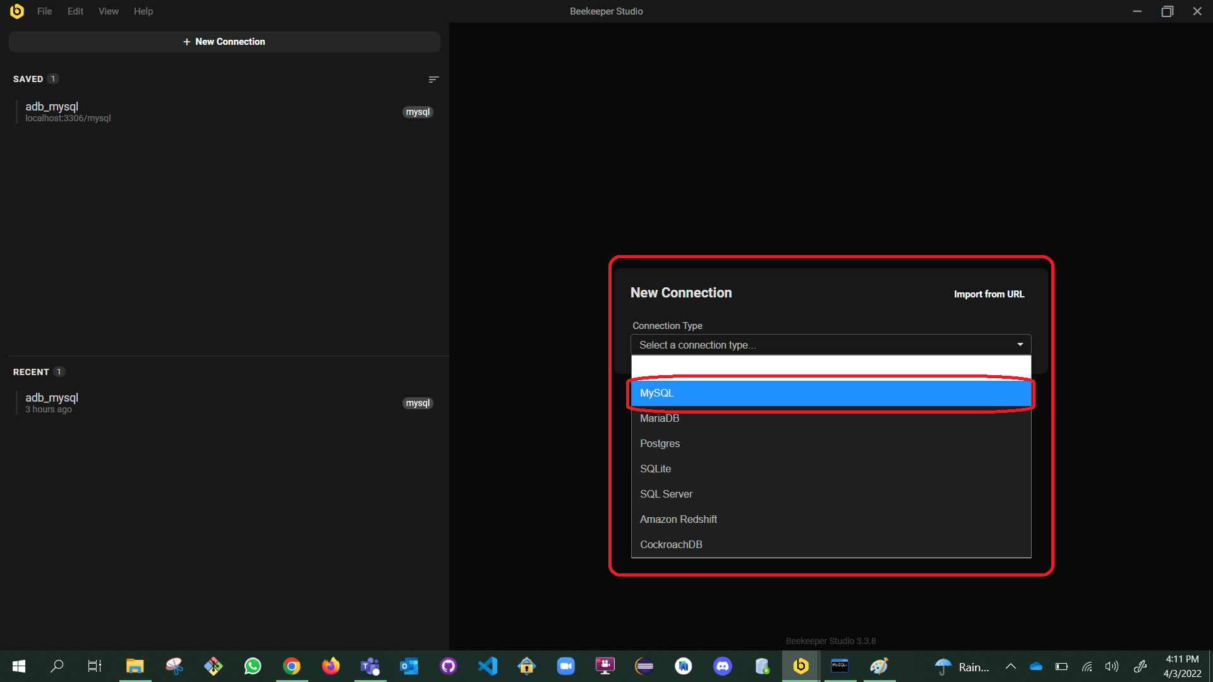
Click on the dropdown so that you can see many Connection Types, in which we choose “MySQL”.

Slide 11
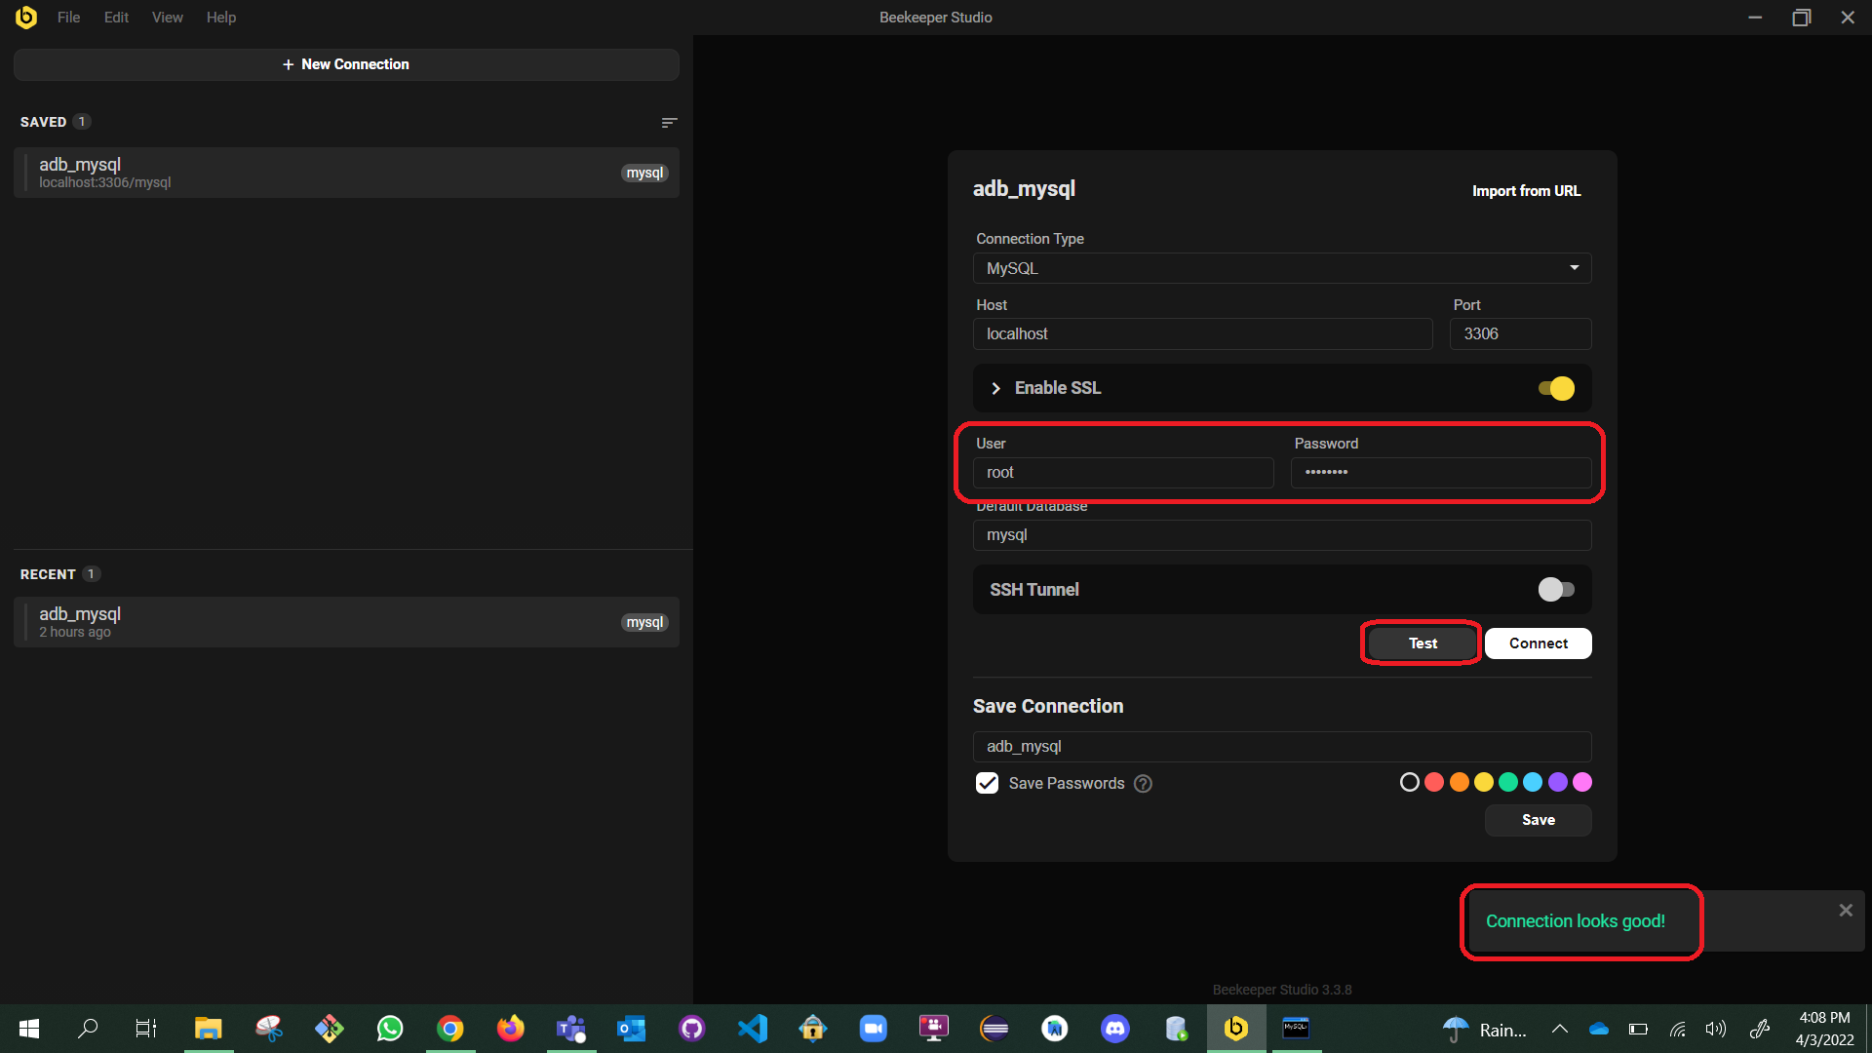
“Enable SSL”
Set the User as “root” & Password as “password”
Default Database as “mysql”
Save Connection as “adb_mysql”
\ and click on the Test so that you can see a pop stating “Connection looks good!”
\ and click on connect.

Slide 12
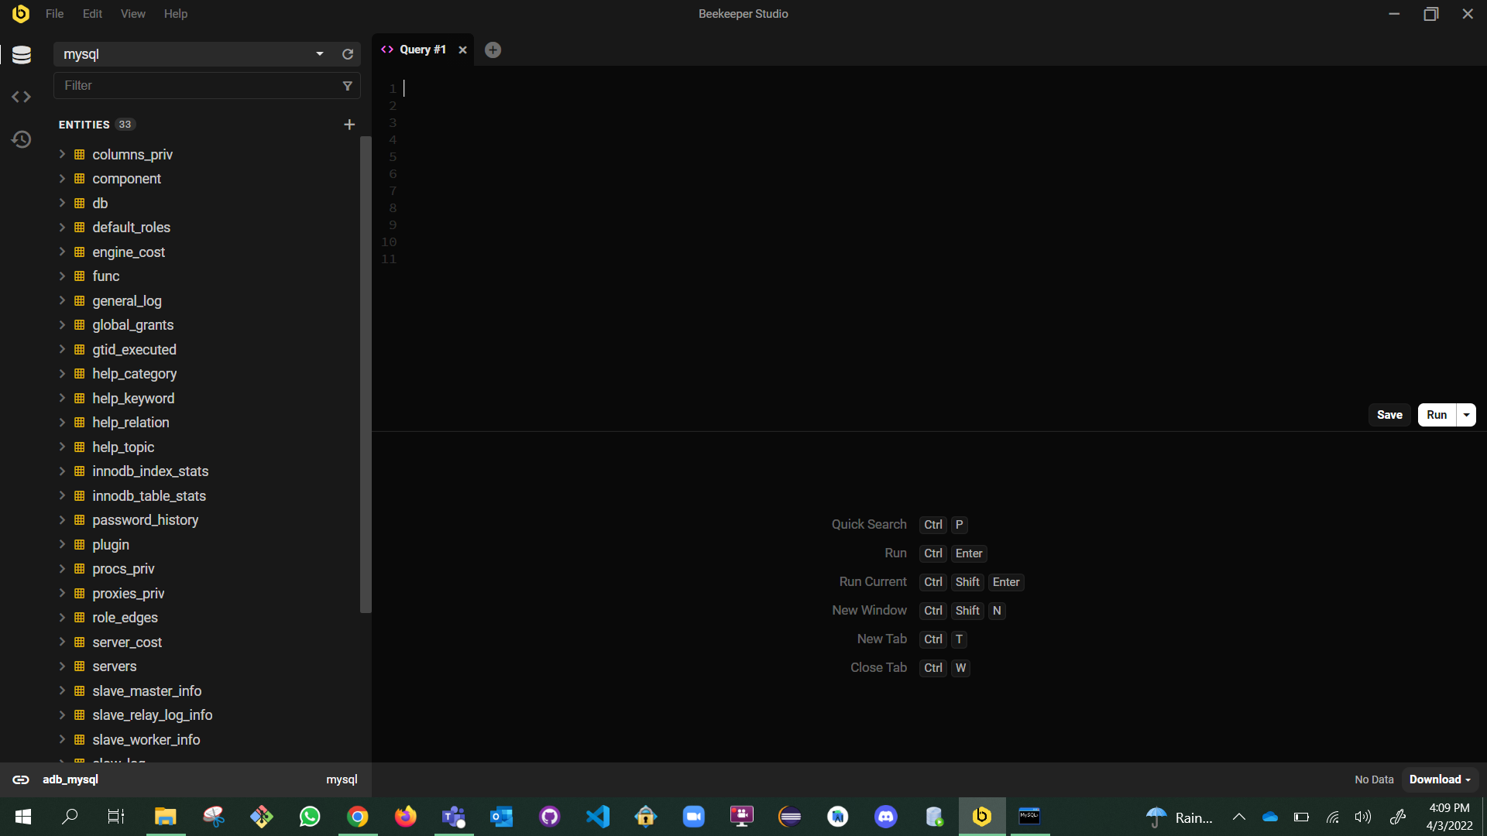
When you click on “Connect” you will see a Blank “Query window”.

Slide 13
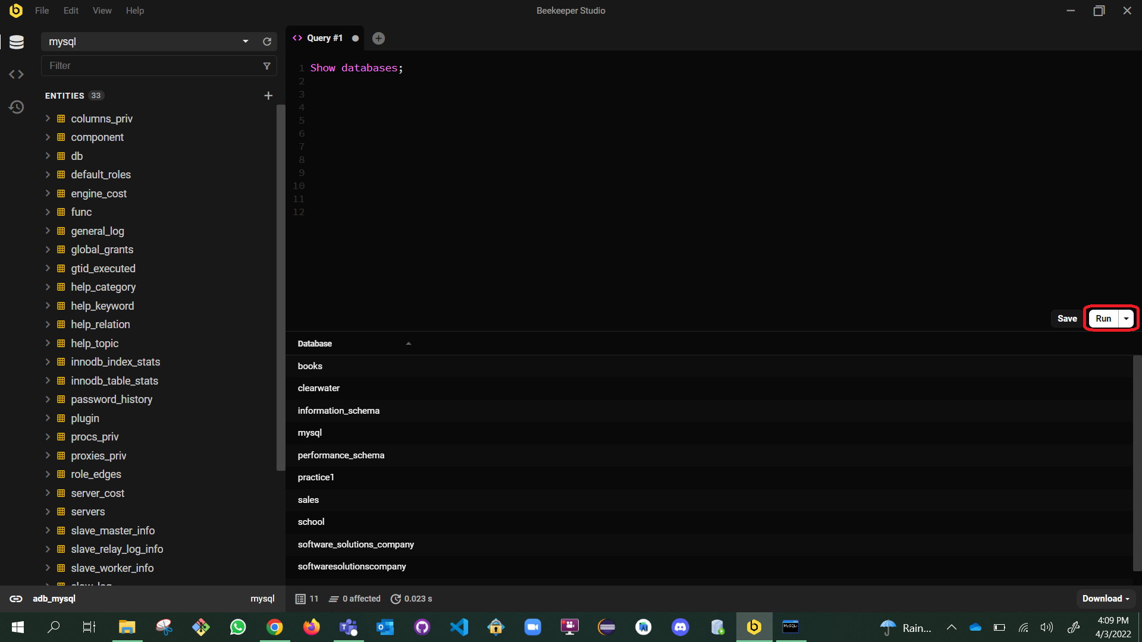
We can start by typing Queries & click on the “Run” button which is on right most middle of the window.
The Output can be seen below.

Slide 14
Milestone - 02

Slide 15
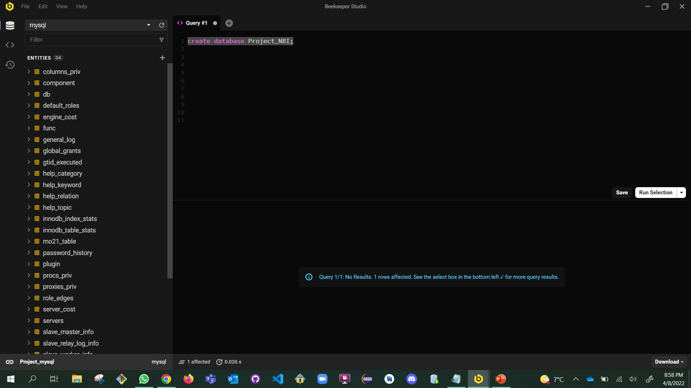
Create a Database entitled as “Project_NBI” by using a query as show in the current slide.

Slide 16
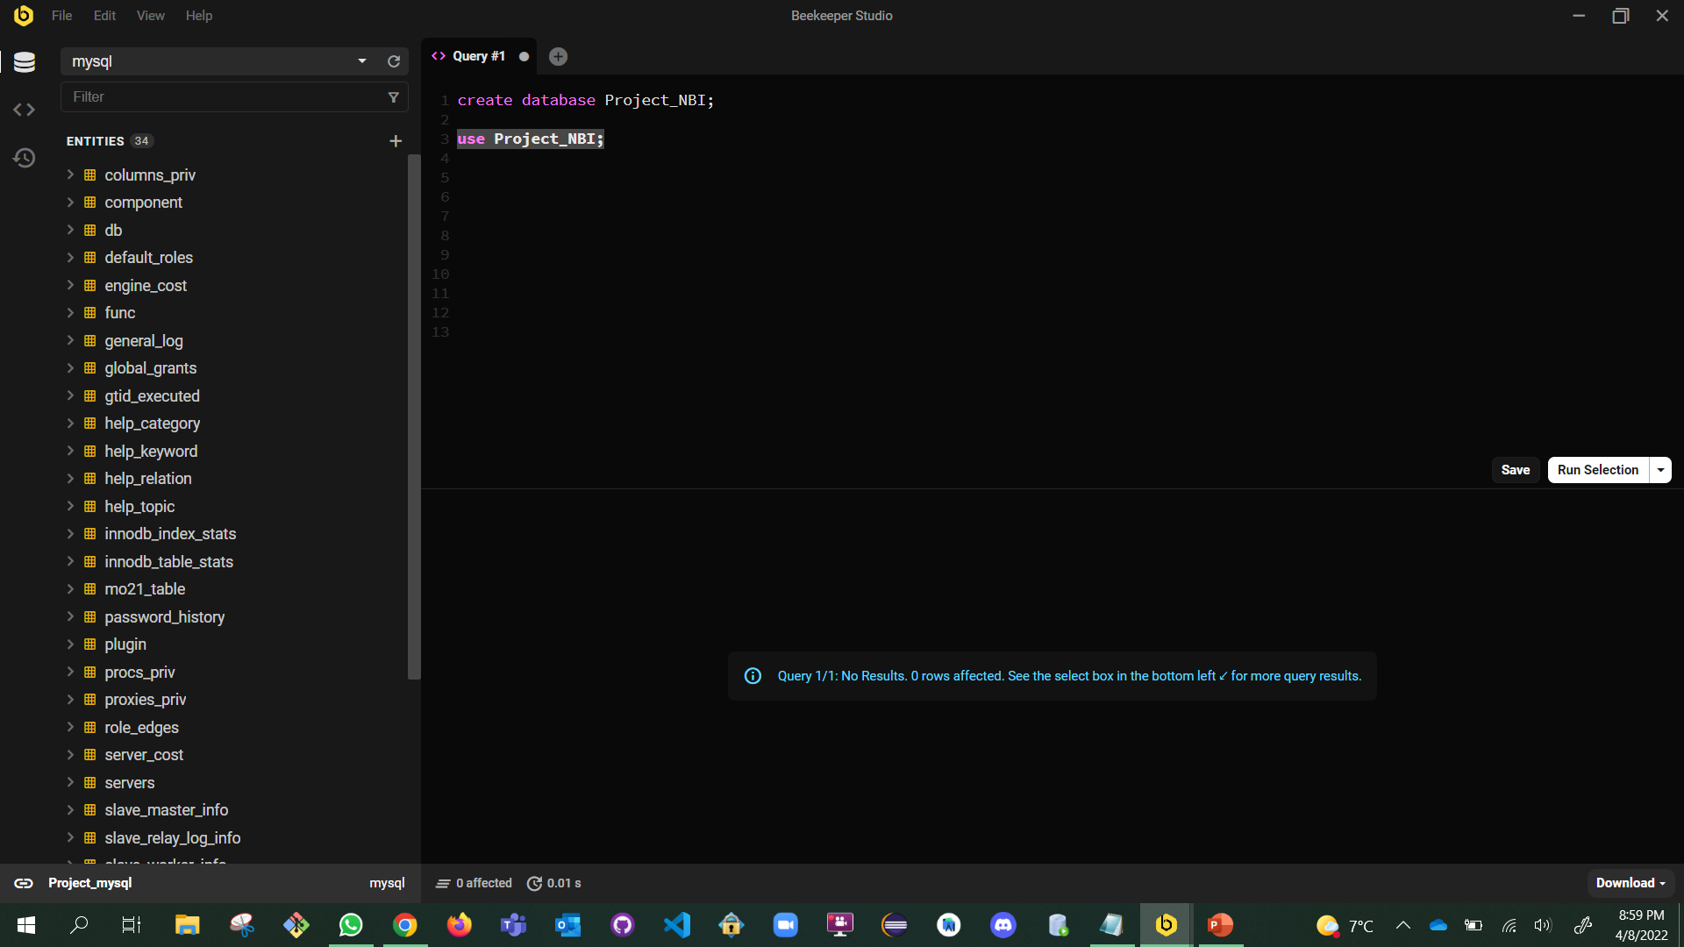
Use the database the one which we have created.

Slide 17
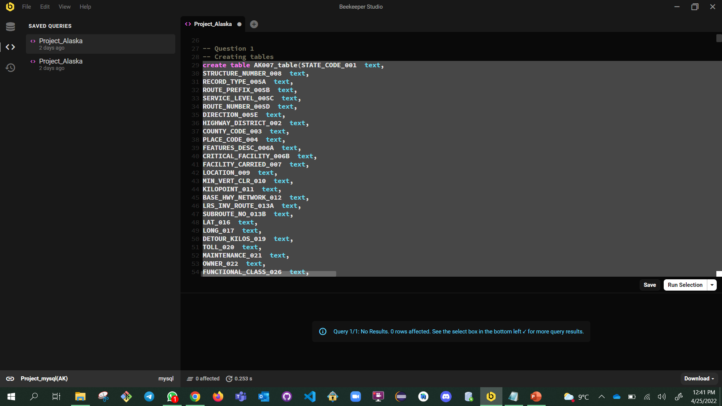
Now create a table by selecting the attributes from the dataset.

Slide 18
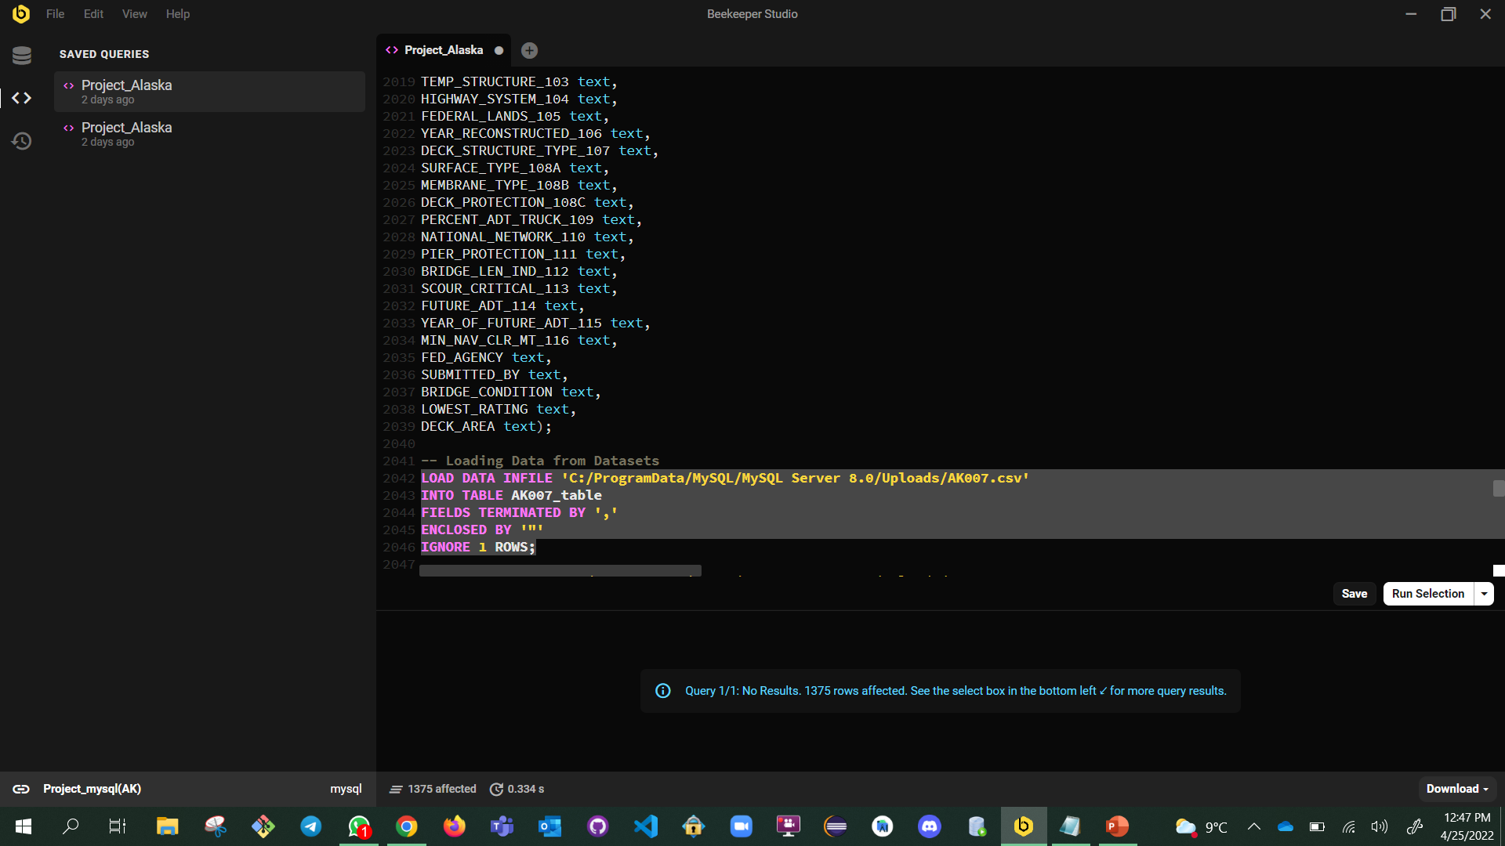
Now import the dataset into the newly created table.

Slide 19
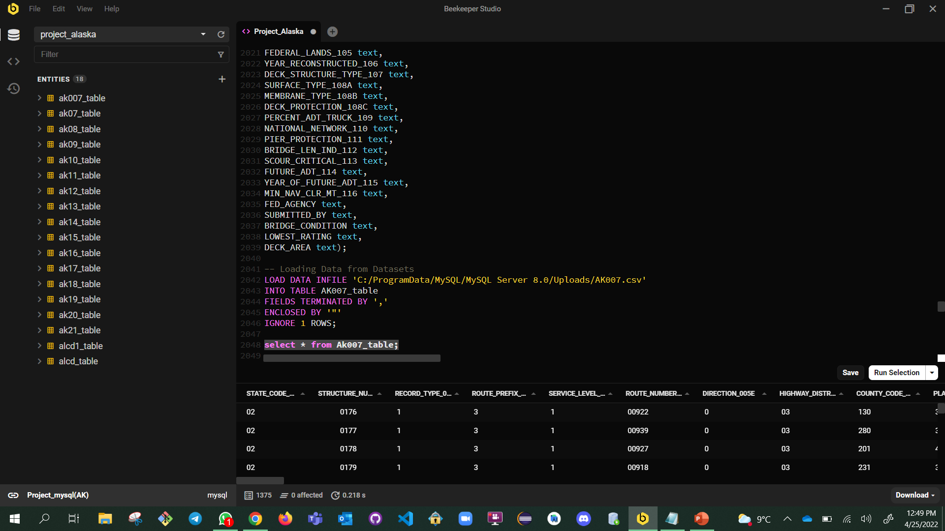
After loading the data into the table, we have to see all the attributes data in the console window for all columns and rows.
The same process is repeated to import the data for the remaining datasets from 2007-2021

Slide 20
Milestone - 03

Slide 21
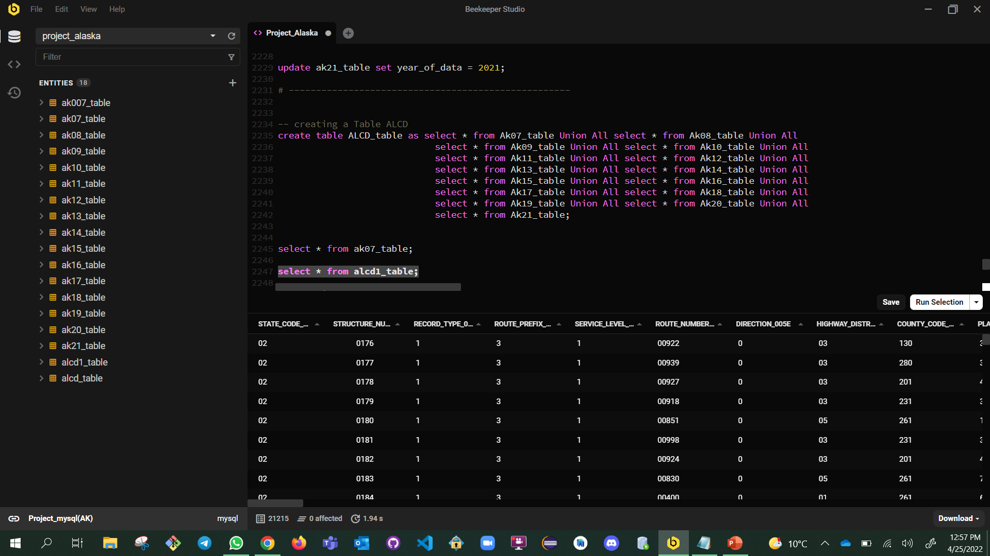
This query responds to combining of all datasets into one dataset, which is entitled as “ALCD.”

Slide 22
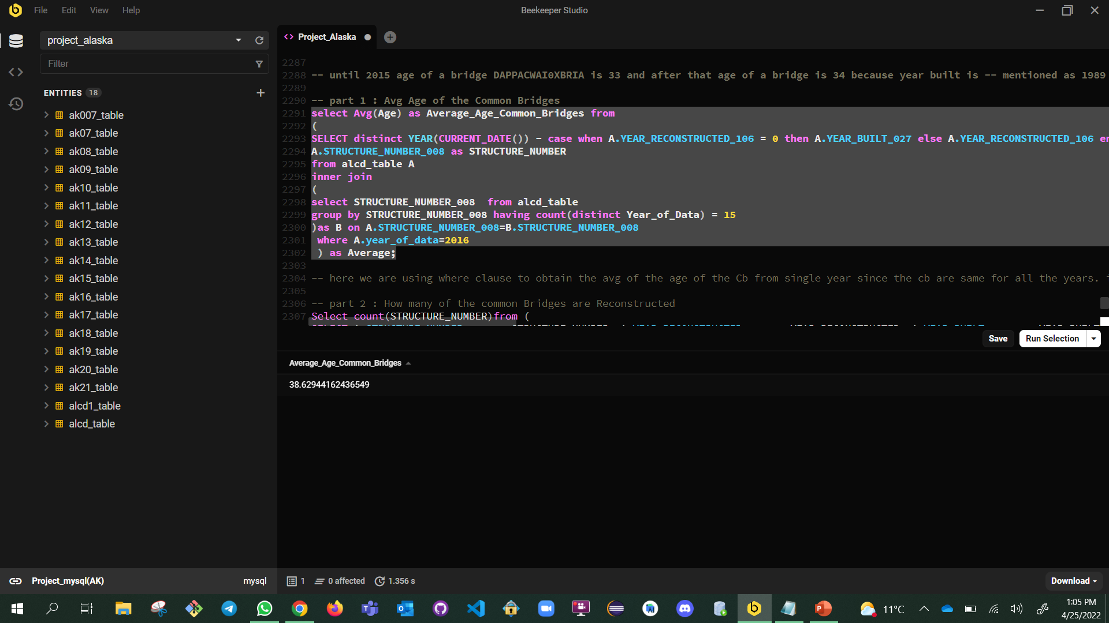
This query gives us “Average age of Common Bridges of all years, which is “38.62.”

Slide 23
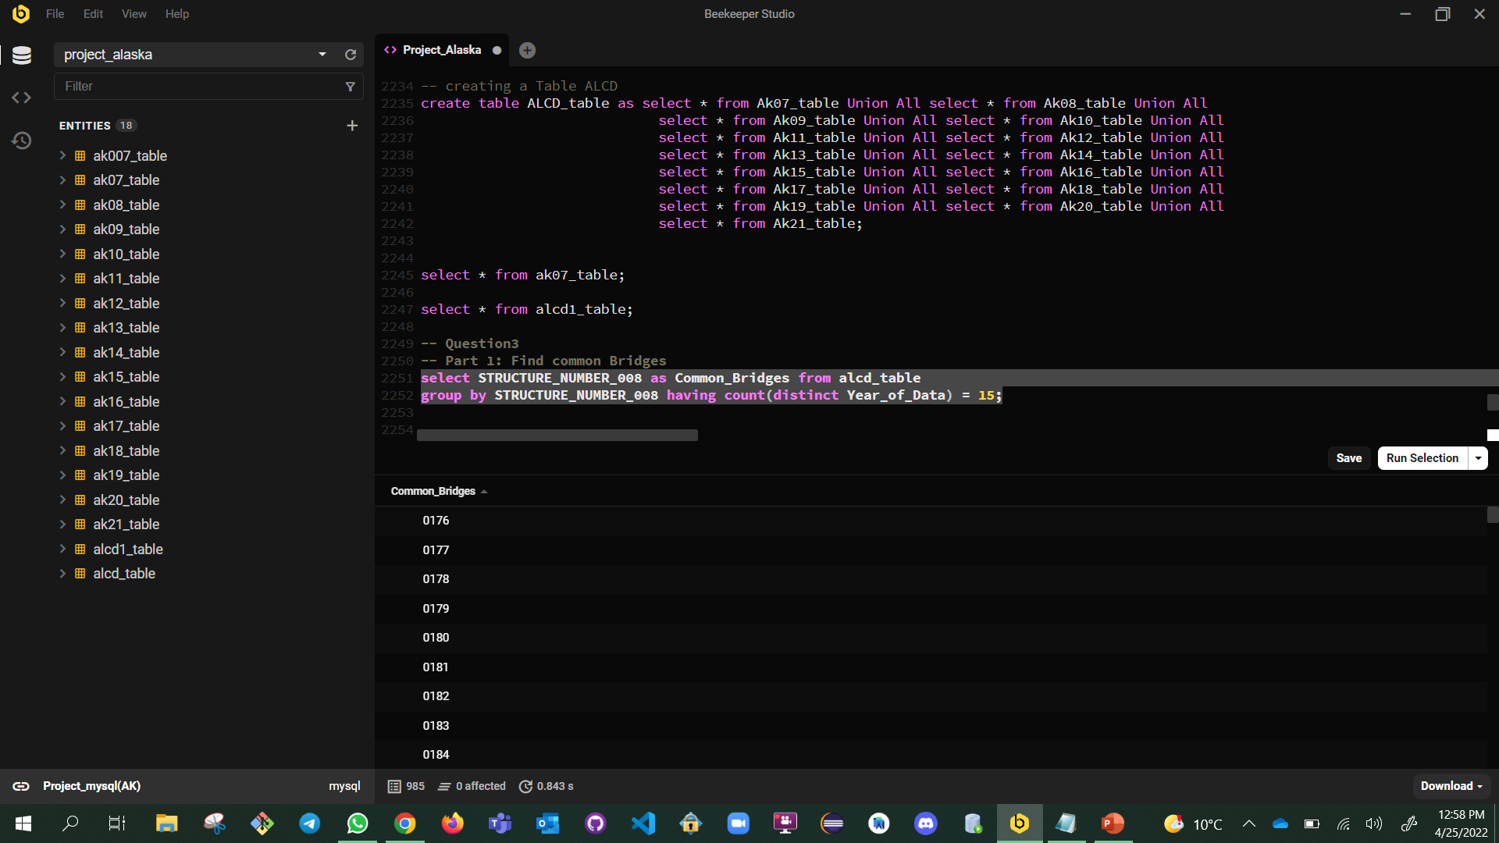
After combining all datasets into one dataset, we have found all common bridges which is present in all 15 years, which is “985.”

Slide 24
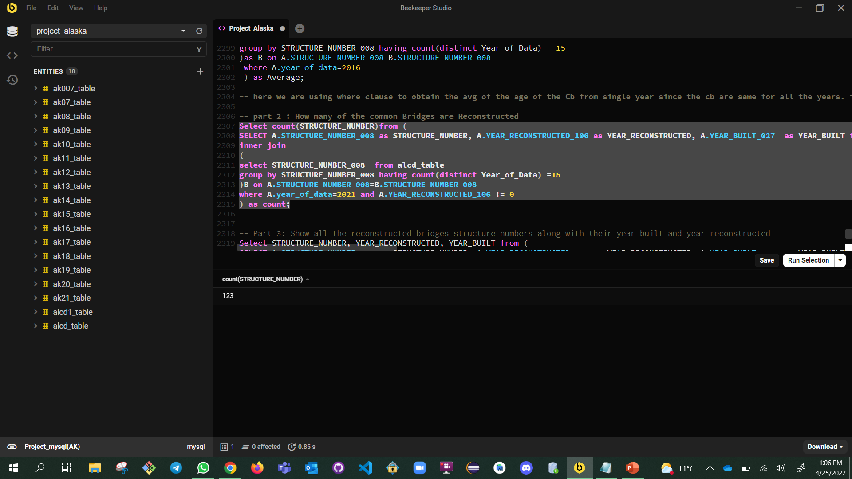
This slide tells us the count of the common bridges which are reconstructed. Hence it is “123.
”

Slide 25
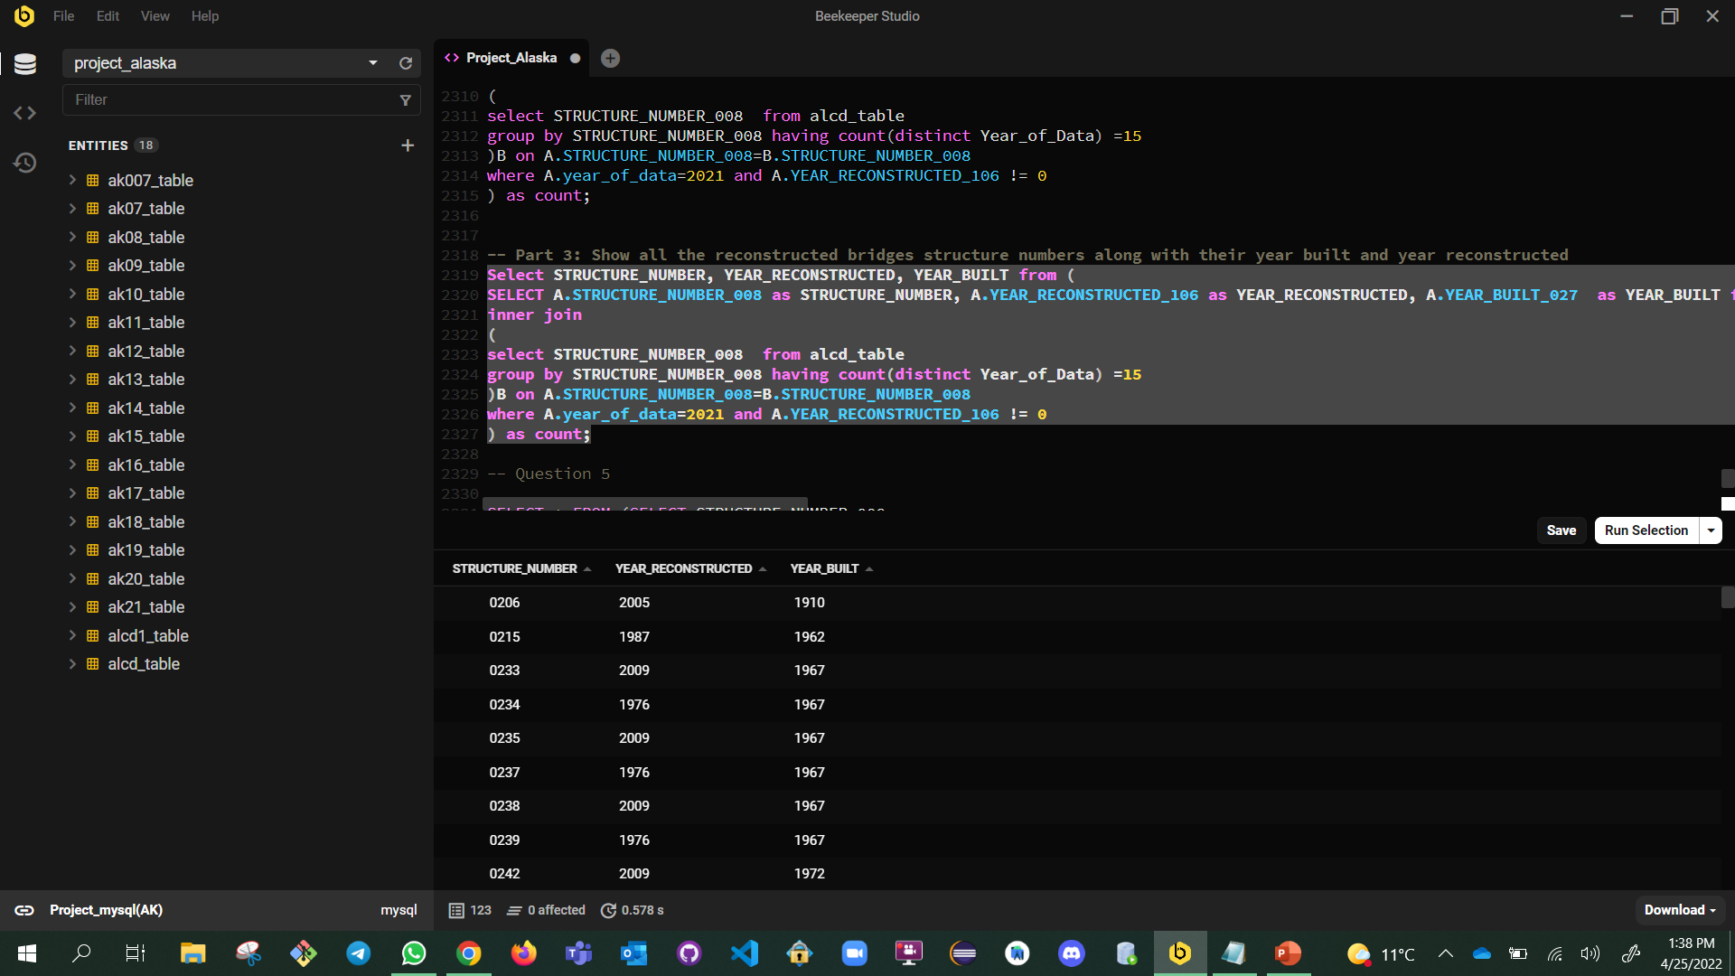
This depicts about Year_Reconstructed and Year_Built.

Slide 26
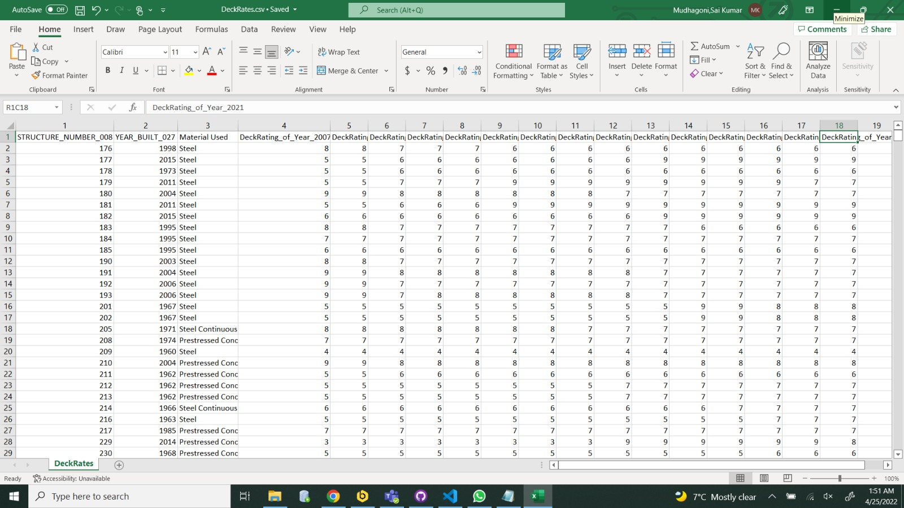

Slide 27
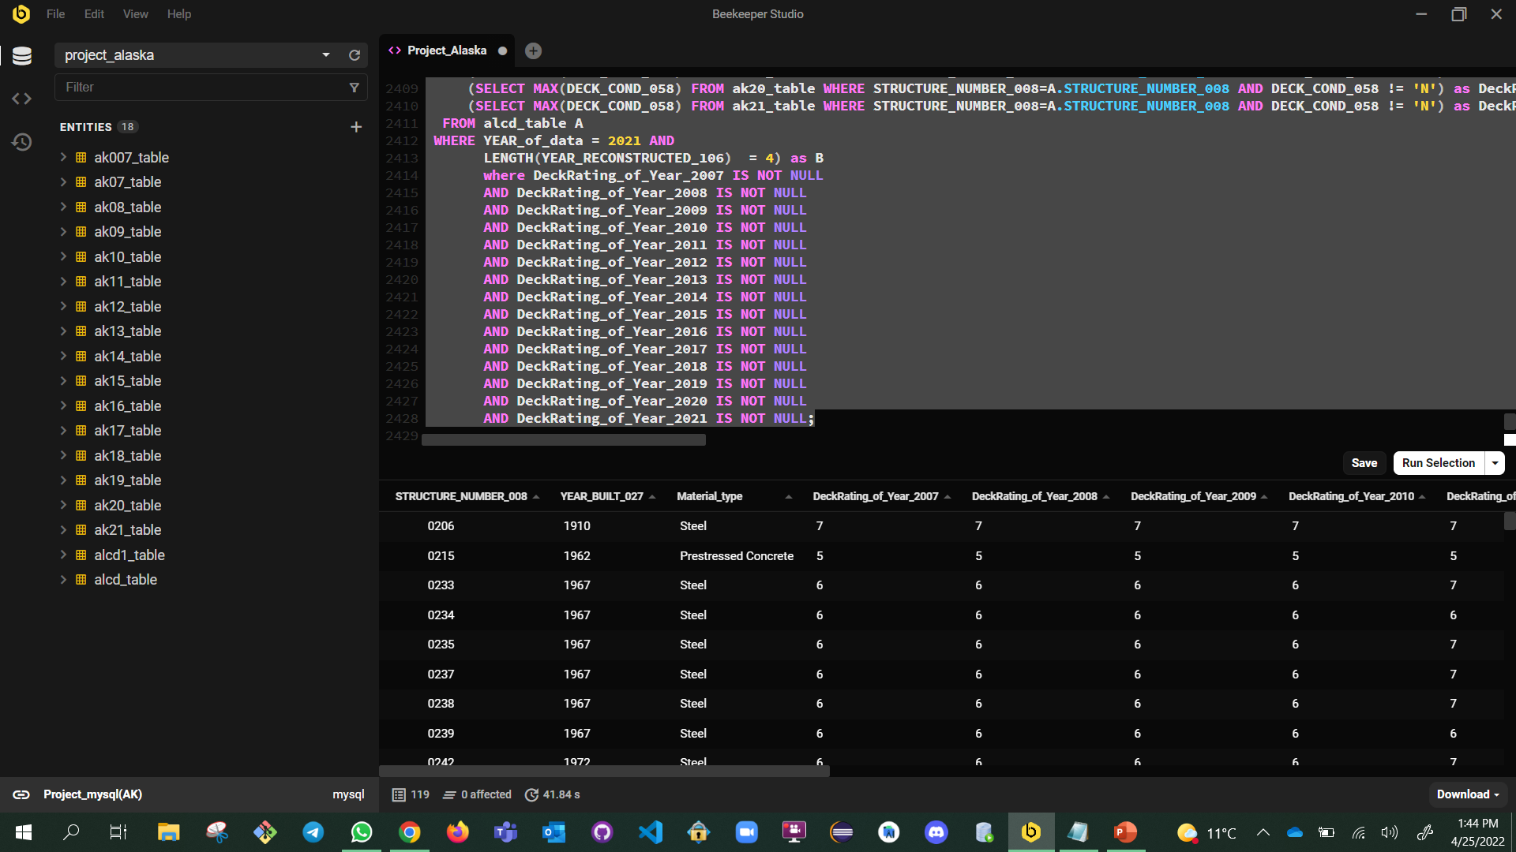
Finally, we have found deck ratings for all years.

Slide 28
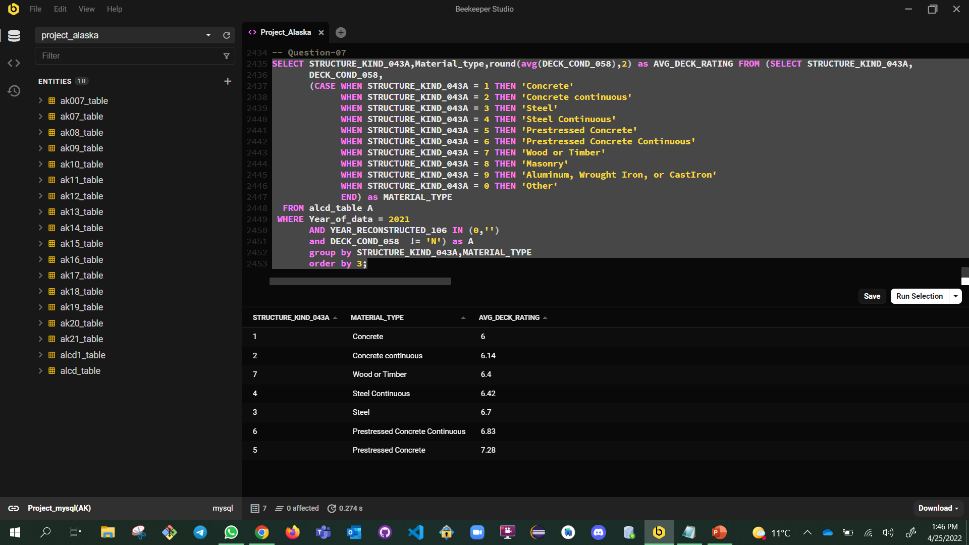
Based on the above results the average rating of all those structures are sho
The Material type “Prestressed Concrete” perform better “AVG_DECK_RATING”.

Slide 29
The End
Thank you!

